Slide 1
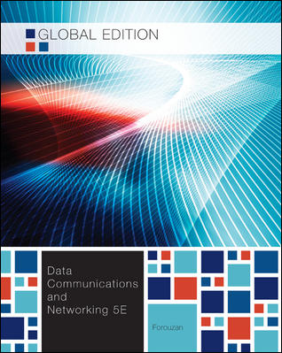
Chapter 15
Wireless LANs

Slide 2
Chapter15: Outline
15.1 INTRODUCTION
15.2 IEEE 802.11 PROJECT
15.3 BLUETOOTH

Slide 3
Chapter 15: Objective
The first section introduces the general issues behind wireless LANs and compares wired and wireless networks. The section describes the characteristics of the wireless networks and the way access is controlled in these types of networks.
The second section discusses a wireless LAN defined by the IEEE 802.11 Project. This section defines the architecture of this type of LAN and describes the MAC sublayer.
The third section discusses the Bluetooth technology as a personal area network (PAN). The section describes the architecture of the network, the addressing mechanism, and the packet format. Different layers used in this protocol are also briefly described and compared with the ones in the other wired and wireless LANs.

Slide 4
15.1 Introduction to Wireless LAN
Wireless communication is one of the fastest-growing technologies.
The demand for connecting devices without the use of cables is increasing everywhere.
Wireless LANs can be found on college campuses, in office buildings, and in many public areas.

Slide 5
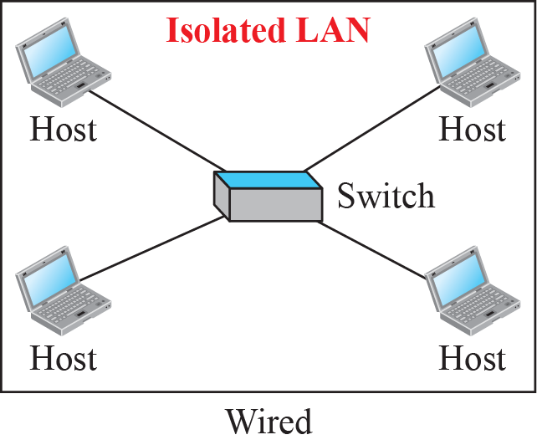
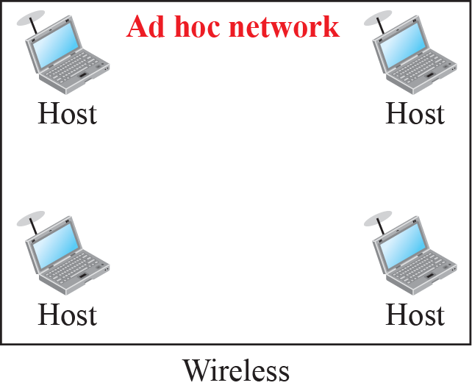
15.1 Introduction to Wireless LAN
Progress of Ethernet
  Multiple Access ➔ Point-to-Point, Full Duplex
Wireless LAN
  Multiple Access
Isolated LAN
  Wireless Ad Hoc Network : it does not rely on a pre-existing infrastructure such as access points

Slide 6
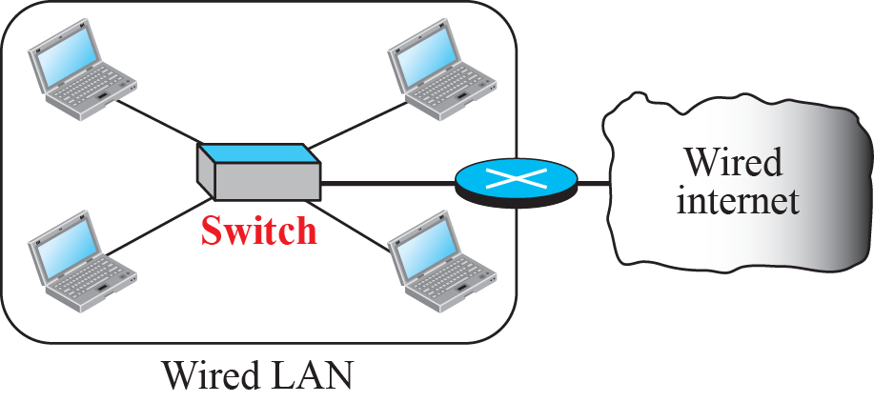
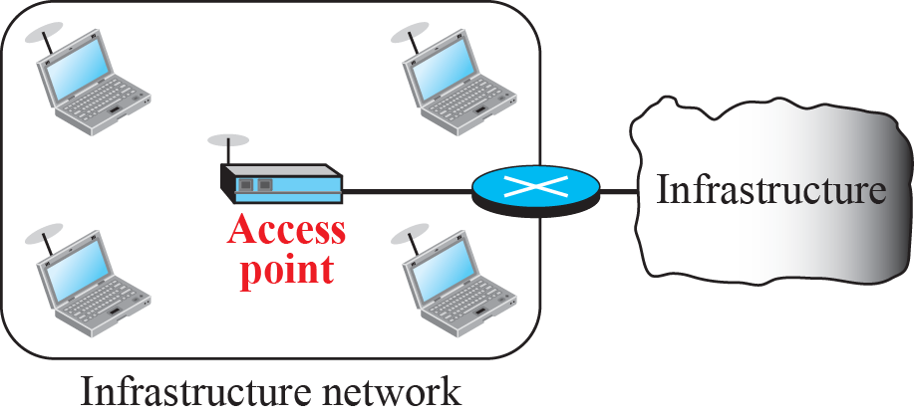
15.1.1 Architectural Comparison
Connection of a wired LAN and a wireless LAN to other networks
Access Point (AP)
  Support the connection of multiple wireless devices through their one wired connection.
  One IEEE 802.11 AP should have, at a maximum, 10-25 clients.

Slide 7
15.1.2 Characteristics of Wireless LAN
Attenuation
  The strength of electromagnetic signals decrease rapidly because the signal disperses in all direction.
Interference
  A receiver may receive signals not only from intended sender, but also from other sender.
Multipath Propagation
  A receiver may receive more than one signal from same sender.
Error
  Signal-to-Noise Ratio(SNR) is low, the signal is corrupted by the noise and the data cannot be recovered.

Slide 8
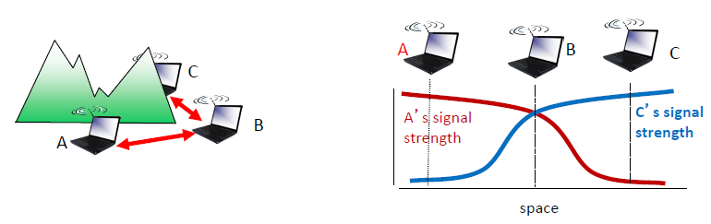
15.1.3 Access Control
How a wireless host can get access to the shared medium (air).
The CSMA/CD algorithm does not work in wireless LANs for three reasons:
  Wireless hosts do not have enough power to send and receive at the same time.
  The hidden station problem prevents collision detection.
  The distance between stations can be great.

Slide 9
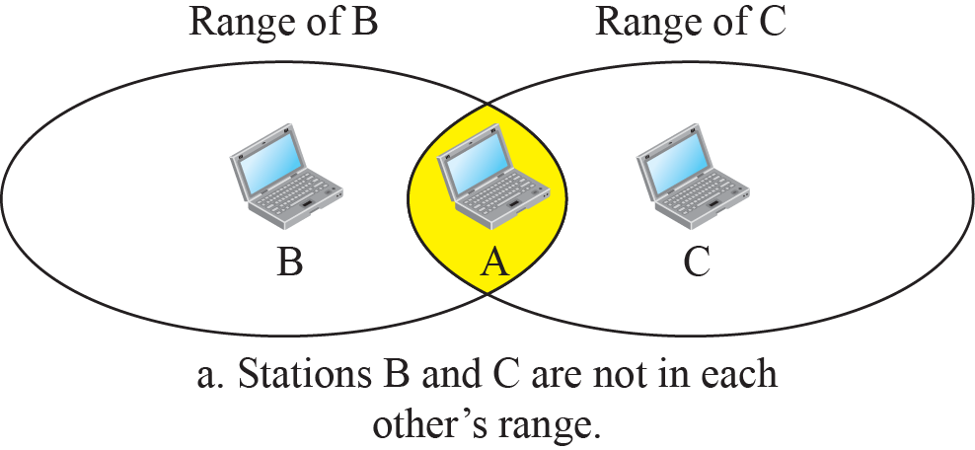
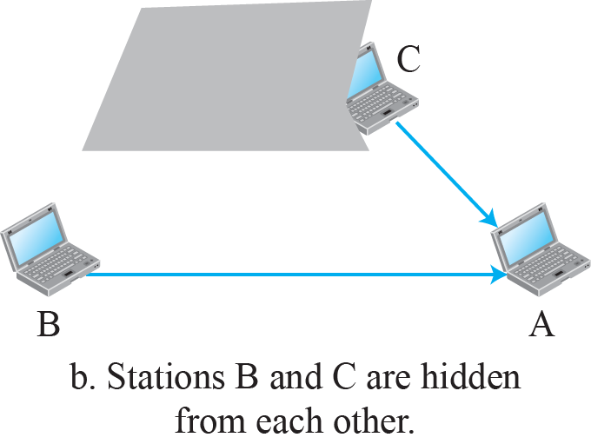
15.1.3 Access Control
Hidden Station Problem

Slide 10
15.2 IEEE 802.11 Project
IEEE 802.11
  It is the specifications for a wireless LAN defined by IEEE.
  It covers the physical and data-link layers.
  It is sometimes called Wireless Ethernet, Wireless LAN, or WiFi.
WiFi(Wireless Fidelity)
  WiFi is a wireless LAN that is certified by the WiFi Alliance.

Slide 11
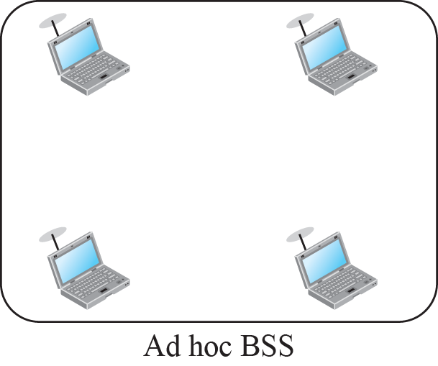
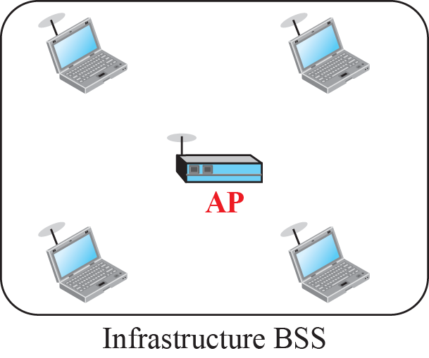
15.2.1 Architecture
Two kinds of architectures :
  Basic Service Set (BSS)
  Extended Service Set (ESS)
Basic Service Set(BSS)
  It is building block of a wireless LAN.
  Ad Hoc BSS : communicate without AP
  Infrastructure BSS : connected to an AP

Slide 12
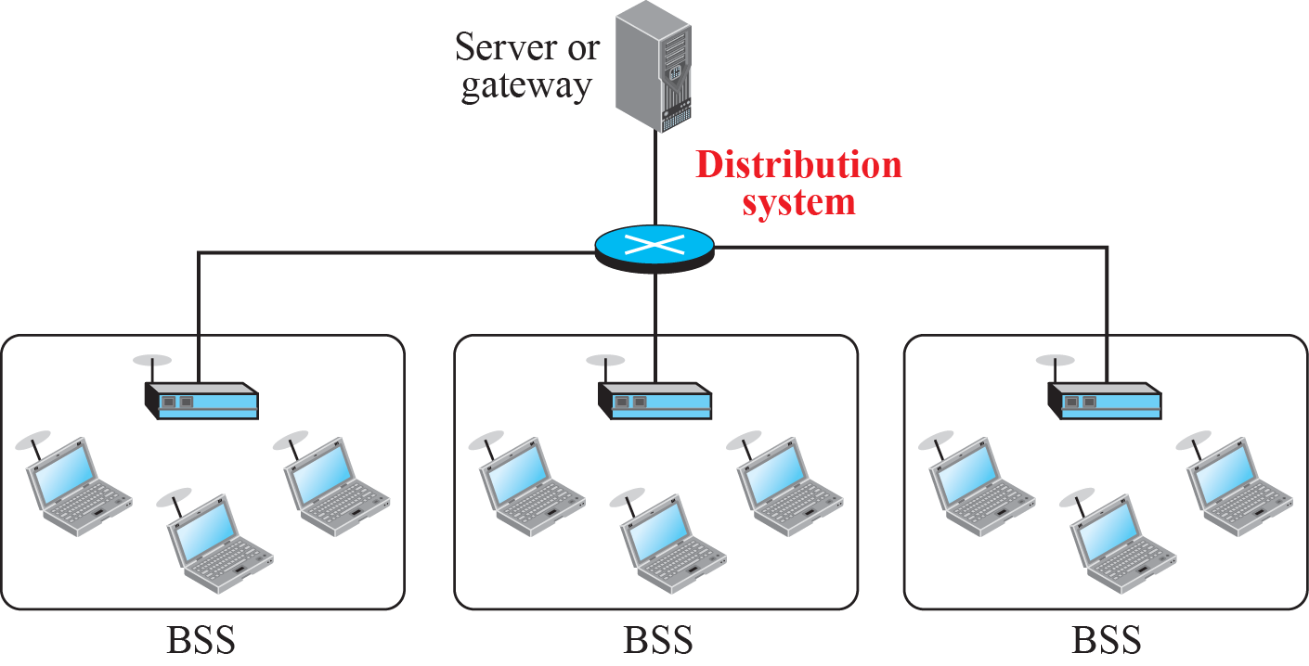
15.2.1 Architecture
Extended Service Set(ESS)
  A set of one or more infrastructure BSS with AP
  Distribution System(DS): the wireless bridging of access points
3 types of mobility
  inside BSS, between BSS, between ESS
ESS (Extended Service Set)

Slide 13
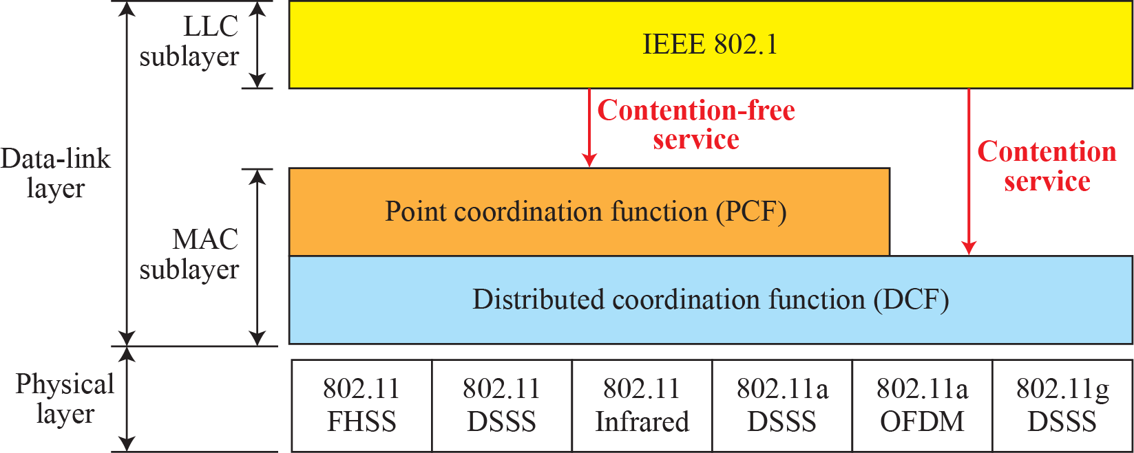
15.2.2 MAC Sublayer
IEEE 802.11 defines two MAC sublayers:
  Distributed Coordination Function (DCF)
  Point Coordination Function (PCF)
The relationship between layers.
802.1(IEEE 802 project), 802.2(LLC),
MAC sublayer
802.3 - CSMA/CD
802.4 - Token Bus
802.5 - Token Ring
802.11 - WIFI
…

Slide 14
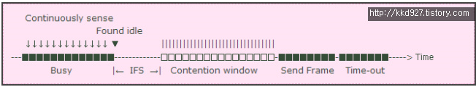
15.2.2 MAC Sublayer
DCF(Distributed Coordination Function)
  DCF uses CSMA/CA as the access method based on contention.
  DIFS: Distributed Interframe Space
Frame Exchange Time Line
  Frame을 보내는 발신 Station은 발신 전에 매체를 Sensing함
  채널이 비어 있으면 DIFS 시간 동안 기다린 후, RTS Frame을 전송함
  RTS 수신 한 후, SIFS 시간 동안 기다린 후, CTS Frame을 전송함
  발신 Station은 SIFS 시간 동안 기다린 후, Data를 보내고 ACK를 수신함

Slide 15

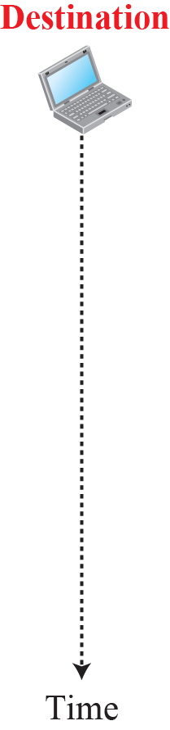











15.2.2 MAC Sublayer
CSMA/CA & NAV
  Collision only occurs during handshake period (RTS, CTS)
  DIFS: Distributed Interframe Space
  SIFS: Short Interframe Space
  RTS: Request To Send CTS: Clear To Send

Slide 16
15.2.2 MAC Sublayer
Network Allocation Vector (NAV)
  When a station sends an RTS frame, it includes the duration of time that it needs to occupy the channel.
  NAV is how much time must pass before the stations are allowed to check the channel for idleness.

Slide 17

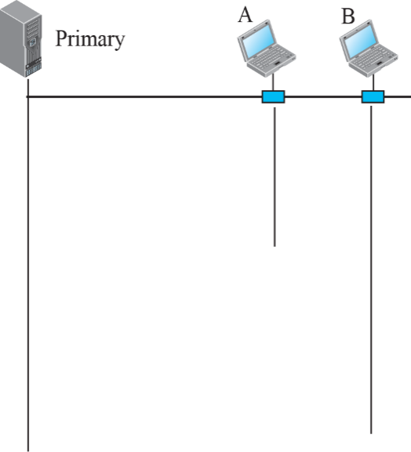



15.2.2 MAC Sublayer
PCF(Point Coordination Function)
  PCF is a MAC technique used in IEEE 802.11 based WLANs.
  It resides in AP(Access Point) to coordinate the communication within the infrastructure network.
    PCF has a centralized contention-free polling access method.
    The point coordinator sends CF-Poll frame to the PCF capable station to permit it to transmit a frame.
    In case the polled station does not have any frames to send, then it must transmit null frame.

Slide 18
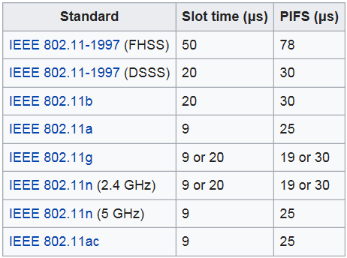
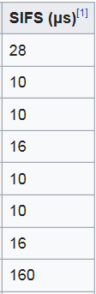


15.2.2 MAC Sublayer
PIFS(PCF IFS)
  DIFS < PIFS duration < SIFS
  As the point coordinator (AP) always has more priority to access the channel, PCF has priority over DCF.
  PIFS duration can be calculated as follows:
    PIFS = SIFS + Slot time
    DIFS = SIFS + (2 * Slot time)

Slide 19
15.2.2 MAC Sublayer
Repetition Interval
  It is designed to cover both (Contention free) PCF and (Contention Based) DCF traffic.
  It starts with a special control frame called Beacon Frame.
  When stations hear the Beacon frame, they start their NAV for the duration of the contention free period of the repetition interval.

Slide 20
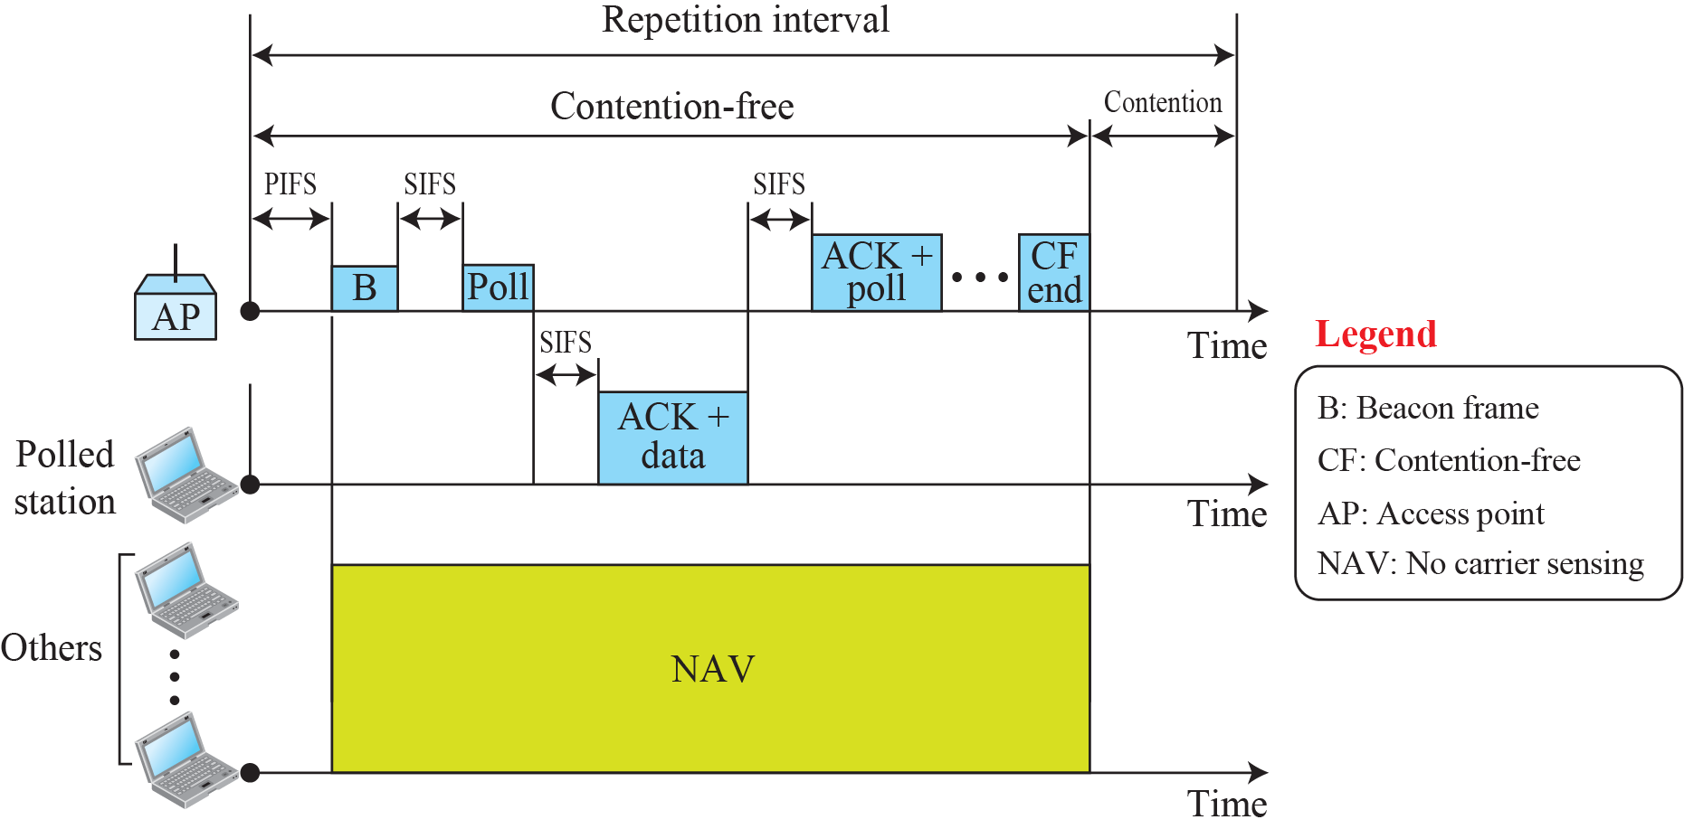
15.2.2 MAC Sublayer
Example of Repetition Interval

Slide 21

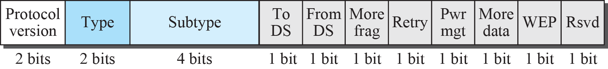
15.2.2 MAC Sublayer
Fragmentation
  A corrupted frame has to be retransmitted.
  It is more efficient to resend a small frame than a large frame.
Frame Format
D(Duration): To set the value of NAV
SC(Sequence Control)
Fragment No.(4bit) + Sequence No.(12bit)
FC: Frame Control
Frame type & Control Information

Slide 22
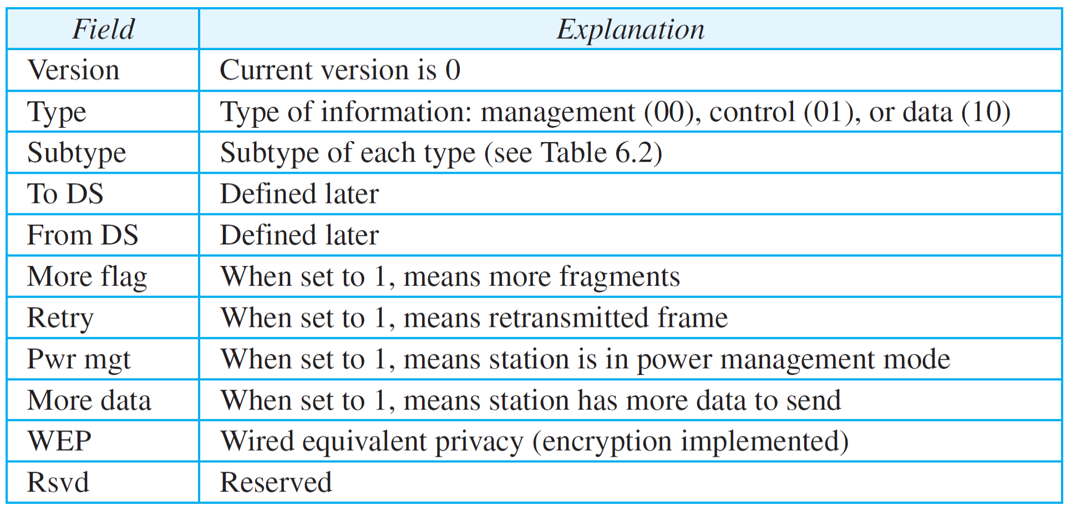
15.2.2 MAC Sublayer
Subfields in FC field

Slide 23
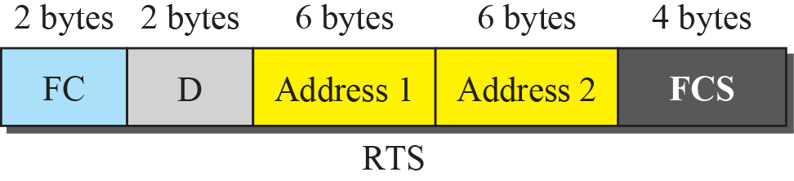
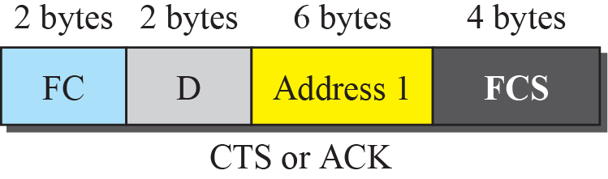
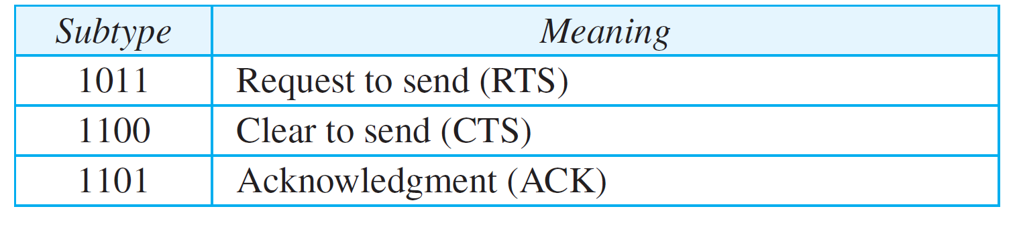
15.2.2 MAC Sublayer
Control Frame
  For accessing the channel and acknowledging
Type
00 Management
01Control
10 Data

Slide 24

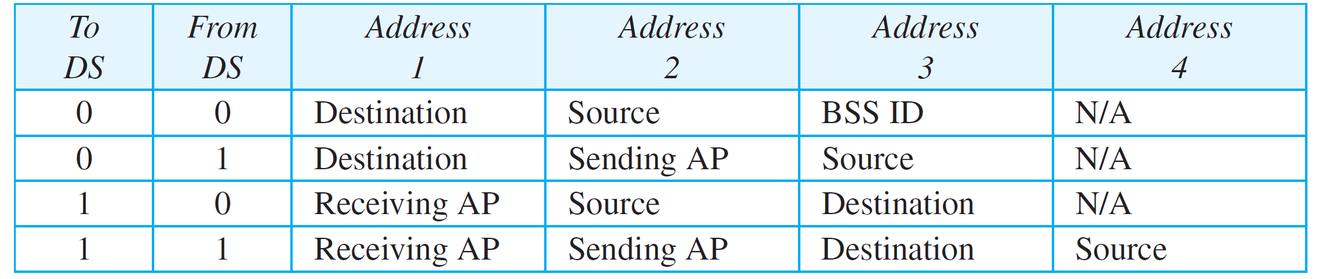
15.2.3 Addressing Mechanism
Four different cases of addressing mechanism
  Defined by the value of the two flags in the FC field, To DS and From DS. ➔ Four different situations
ⓑ
ⓒ
ⓐ
ⓓ
ⓐ
ⓑ
ⓒ
ⓓ

Slide 25
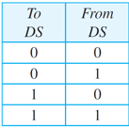
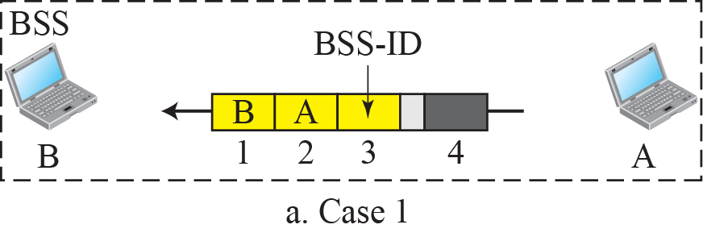
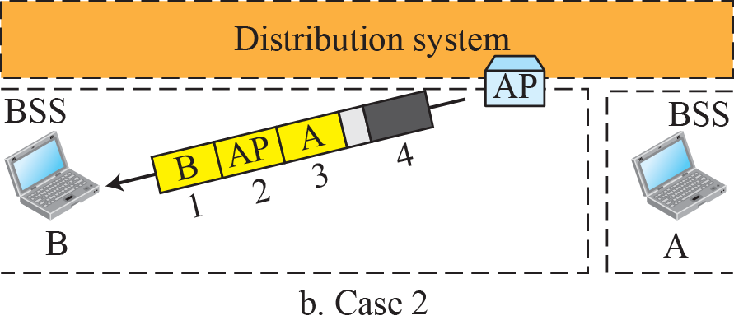
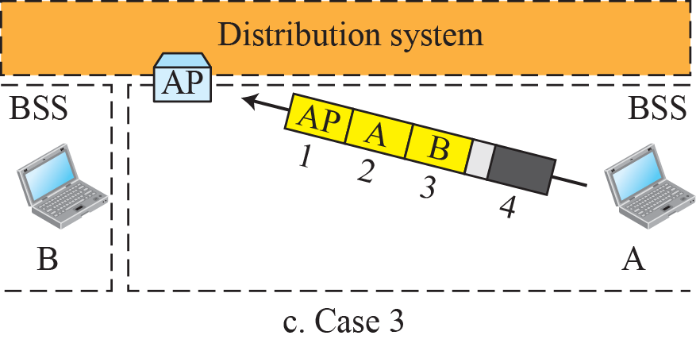
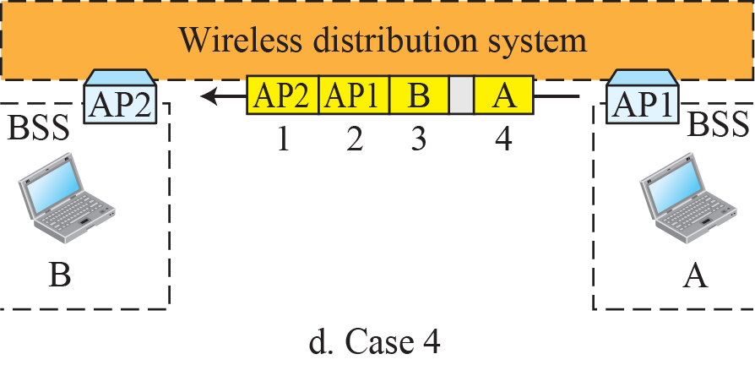
15.2.3 Addressing Mechanism
Addressing mechanisms
ⓐ
ⓑ
ⓒ
ⓓ

Slide 26
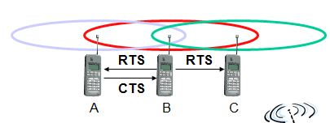
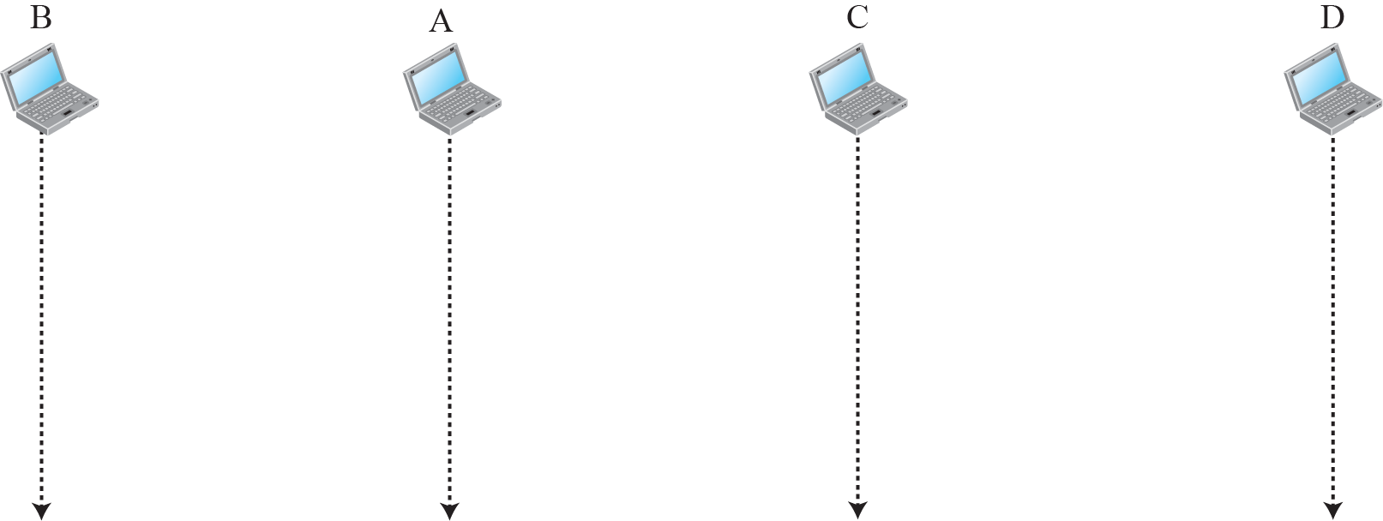
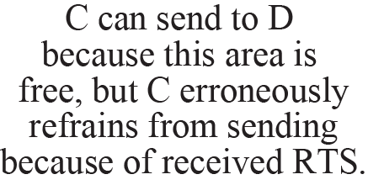


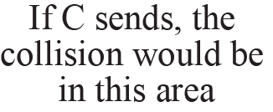
15.2.3 Addressing Mechanism
Exposed Station Problem

Slide 27
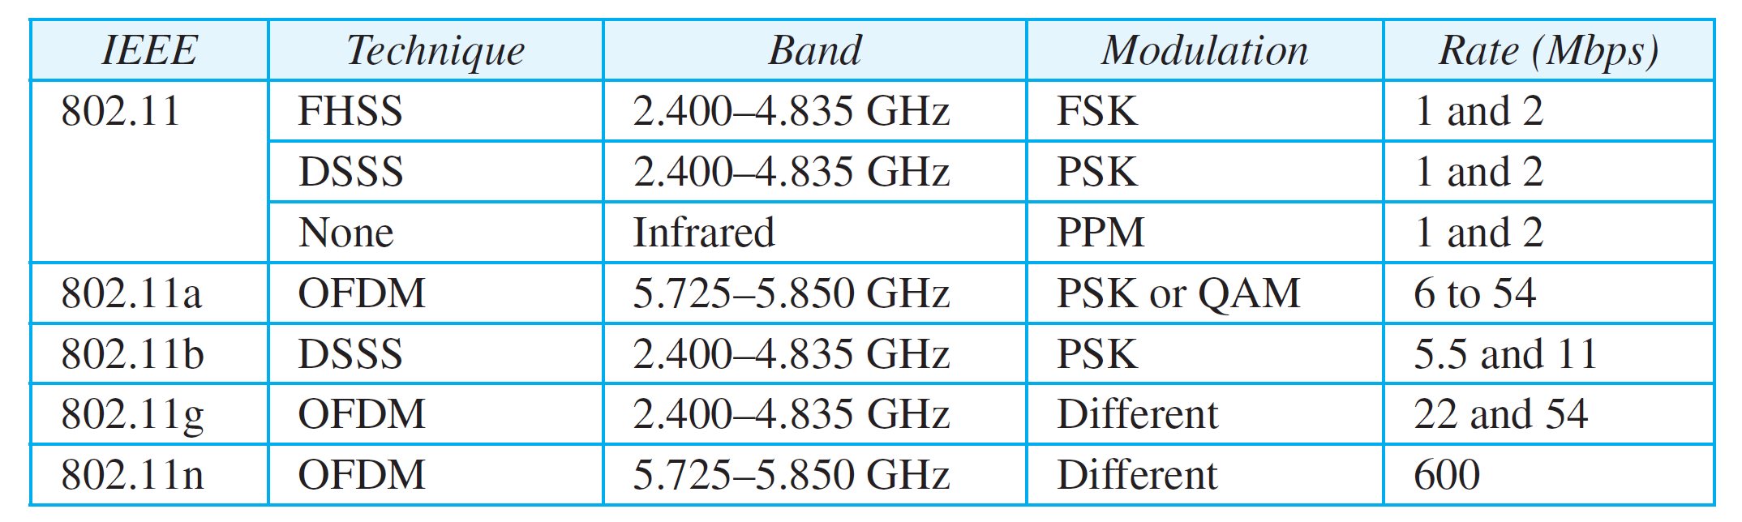
15.2.4 Physical Layer
Specification
ISM(Industrial, Scientific and Medical) Band
  Three unlicensed bands :
  902–928MHz, 2.400–4.835GHz, 5.725–5.850GHz.
  2.4GHz bands can be applied to Wireless LAN, Bluetooth, RFID(Radio Frequency Identification), Codeless Telephone, and so on.

Slide 28
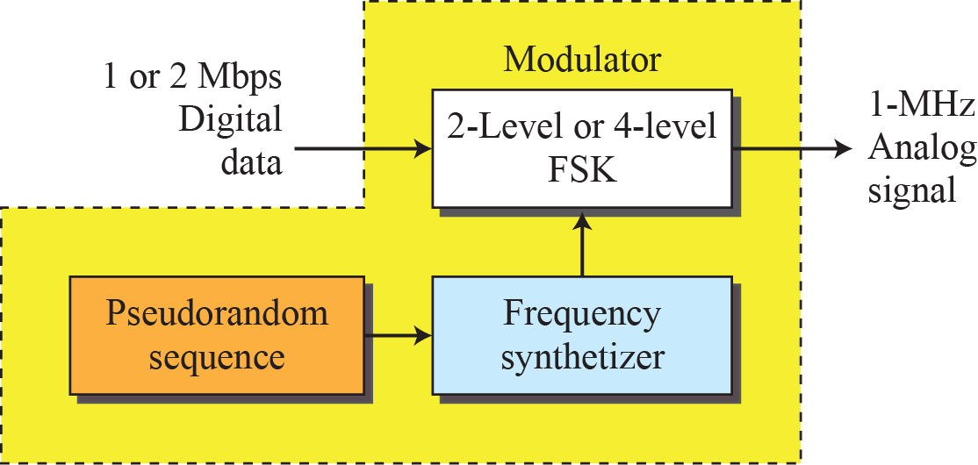
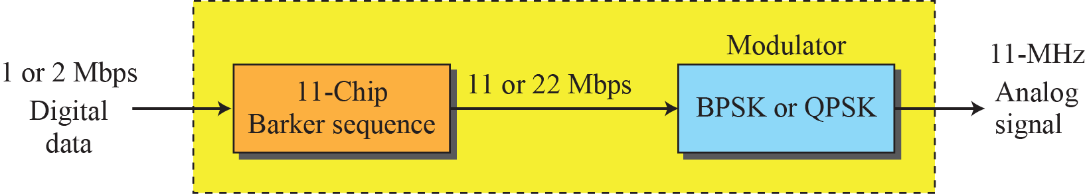
15.2.4 Physical Layer
Physical layer of IEEE 802.11 FHSS
Physical layer of IEEE 802.11 DSSS

Slide 29
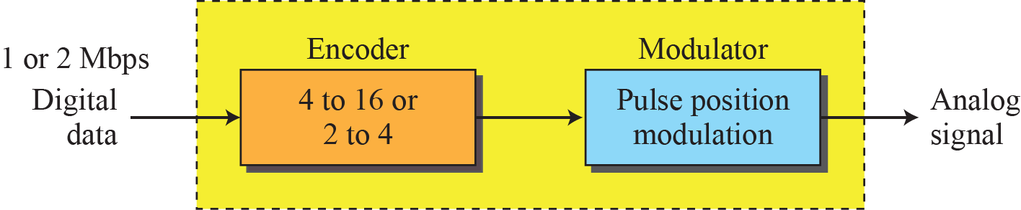
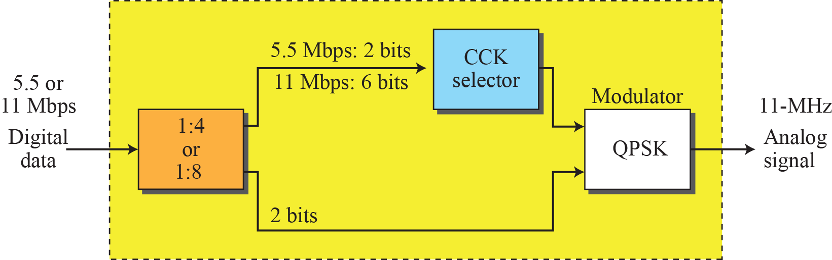
15.2.4 Physical Layer
Physical layer of IEEE 802.11 infrared
Physical layer of IEEE 802.11b

Slide 30

15.3 Bluetooth
Bluetooth
  IEEE 802.15 wireless LAN technology
  Bluetooth connects devices having different functions when they are at a short distance from each other.
  Bluetooth uses a radio technology called Frequency-Hopping Spread Spectrum(FHSS).
A Bluetooth LAN is an ad hoc network.
  Bluetooth is a packet-based protocol with a master/slave architecture.
  One master may communicate with up to seven slaves in a piconet.
  All devices share the master's clock.

Slide 31
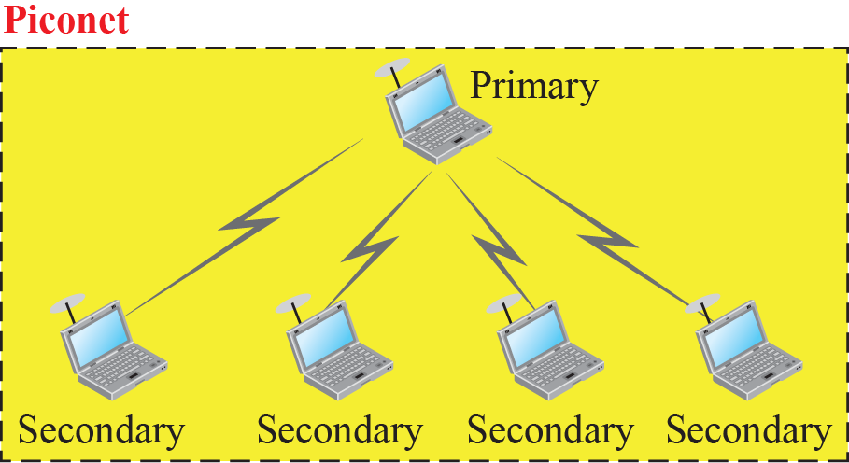
15.3.1 Structure
Piconet – small net
  Only 8 stations can be active piconet : one is primary, the rest is secondaries.
  Secondaries synchronize their clock and hopping sequence with primary.
  A station which is not contained in active piconet stays parked state.

Slide 32
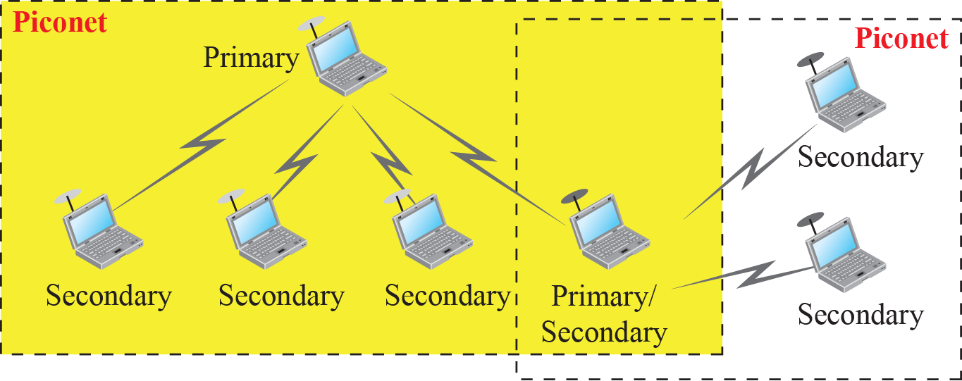
15.3.1 Structure
Scatternet – combination of piconet
  A secondary in one piconet can be the primary in another piconet.
Bluetooth Device
  1Mbps with 2.4GHz bandwidth, short range radio transmitter

Slide 33
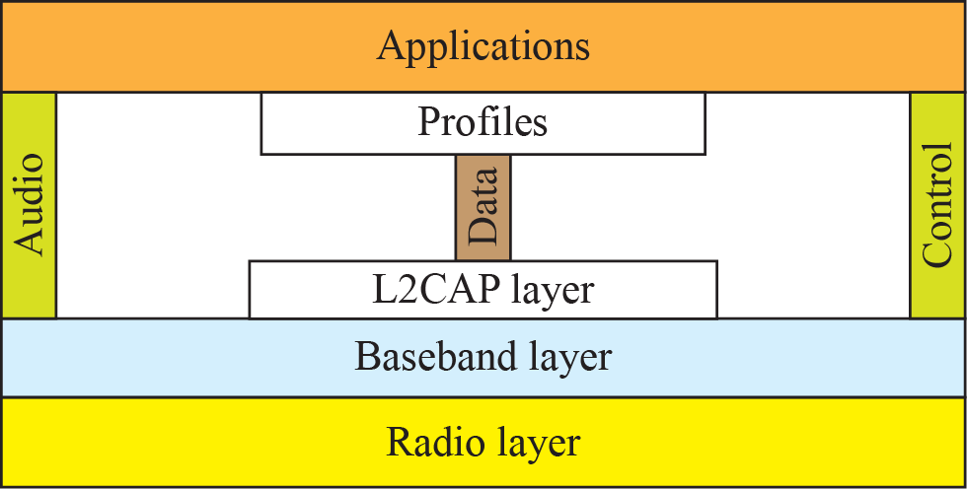
15.3.2 Bluetooth Layers
Bluetooth uses several layers that do not exactly match those of the Internet model.

Slide 34
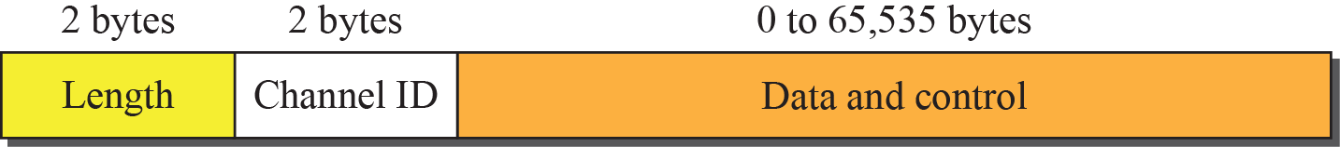
15.3.2 Bluetooth Layers
Logical Link Control and Adaptation Protocol (L2CAP)
  Roughly equivalent to the LLC Sublayer in LAN.
  It is used for data exchage on an ACL.
  Multiplexing, segmentation and reassembly, Quality of Service, group management
L2CAP data packet format

Slide 35
15.3.2 Bluetooth Layers
2. Baseband Layer
  Roughly equivalent to the MAC Sublayer in LAN.
  Time Division Duplex(TDD) TDMA Access Method between primary and secondary - Half Duplex.
  Two kinds of links.
    Synchronous Connection-Oriented (SCO) Link
    Asynchronous Connectionless (ACL) Link

Slide 36

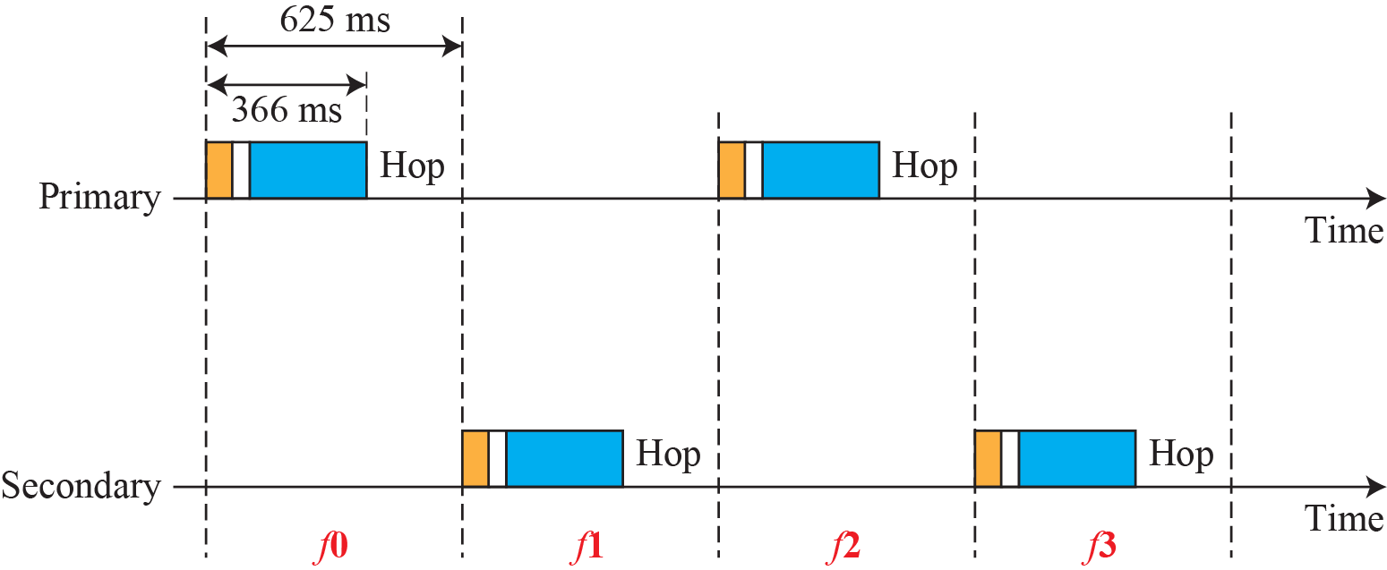

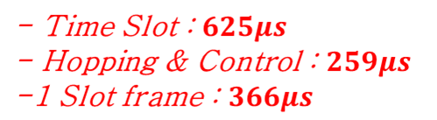
15.3.2 Bluetooth Layers
Single Secondary Communication
  Time is divided into slots of 625us. Half-Duplex TDMA.
  Primary use even-numbered Slot(0, 2, 4, 6 …).
  Secondary uses odd-numbered Slot(1, 3, 5, 7 …).
FHSS 사용
1초에 1600번 Hopping

Slide 37
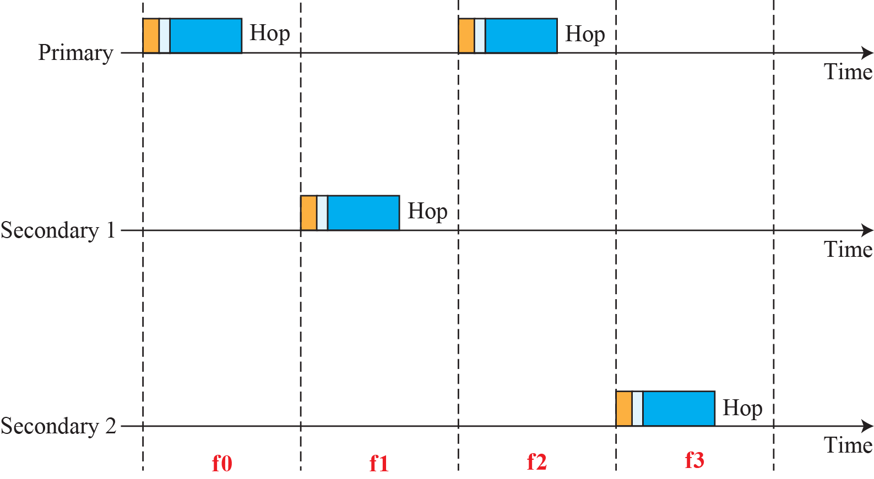
15.3.2 Bluetooth Layers
Multiple Secondary Communication
  Primary use even-numbered Slot(0, 2, 4, 6 …).
  Secondary uses odd-numbered Slot(1, 3, 5, 7 …).
  It is similar to a poll/select operation.

Slide 38
15.3.2 Bluetooth Layers
Synchronous Connection-Oriented (SCO) Link
  Used when delay is more important than integrity (error free) such as voice or audio.
    If a packet is damaged, it is never retransmitted.
    시간적 요인이 중요하고 신뢰성은 크게 요구되지 않는 데이터 전송, 음성 채널로 사용된다.
  625µs의 일정한 시간 간격으로 예약된 Time Slot을 통해 데이터를 주고 받는다.
    625µs는 음성 신호 속도인 64kbps에 맞는 수치이다.

Slide 39
15.3.2 Bluetooth Layers
Asynchronous Connection-less (ACL) Link
  Used when data integrity is more important than avoiding delay.
    If a packet is corrupted, it is retransmitted.
  Point-to-Multpoint의 연결이 가능하나, 하나의 Primary와 Secondary 사이에는 ACL 링크는 반드시 한 개만 설정될 수 있다.
  일반적인 데이터 통신에 이용되며 데이터율은 최대 721kbps이다.

Slide 40
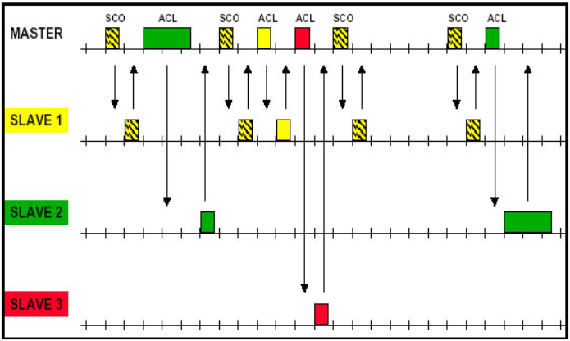
15.3.2 Bluetooth Layers
SCO Link와 ACL Link가 동시에 존재하는 링크
625µs
366 + 259

Slide 41
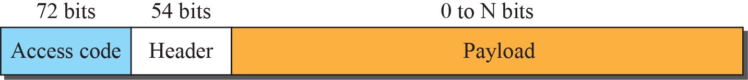
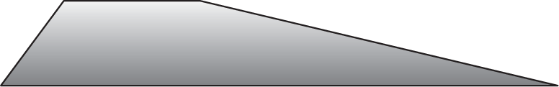
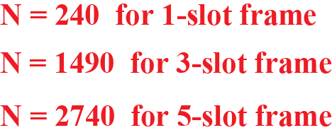
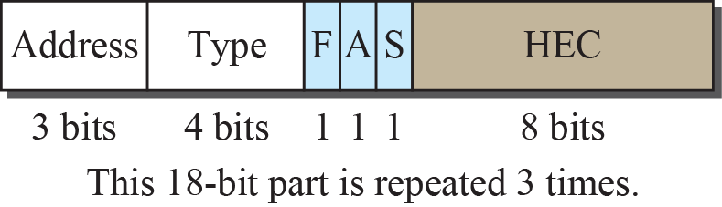
15.3.2 Bluetooth Layers
Frame format types
126bit
625µs – 259µs = 366µs
1Mbps 와 1bit/Hz를 사용하면 366µs는 366bit가 됨
366bit – 126bit = 240bit

Slide 42
15.3.2 Bluetooth Layers
Access code
  Synchronization bits and the identifier of the primary.
Header : 18bit part is repeated 3 times.
  address : It defines up to seven secondaries (1 to 7). 0 is broadcast.
  Type : Type of data from the upper layer
  F : Flow control. When set to 1, it can nor receive more frame.
  A : Acknowledgement. Stop and Wait ARQ
  S : Sequence number. Stop and Wait ARQ
  HEC : Checksum to detect error.
Payload(Data)
  Data or control information

Slide 43

15.3.2 Bluetooth Layers
3. Radio Layer
  Roughly equivalent to the physical layer in Internet.
  Low-power, a range of 10m.
  2.4GHz ISM band divided into 79 channels of 1MHz each.
Frequency Hopping Spread Spectrum (FHSS) 사용
  To avoid interference from other devices.
  Hopping - 1초에 변조 주파수를 1600번 바꾸어 전송
  한 Device가 다른 주파수로 Hopping 하기 전에 동안 한 주파수에 체류하게 됨

Slide 44

15.4 Summary
Introduction to wireless LAN
  The section describes the characteristics of the wireless networks and the way access is controlled in these types of networks.
IEEE 802.11 Project - WIFI
  This section defines the architecture of wireless LAN and describes the MAC sublayer.
Bluetooth
  This section describes the architecture of the Bluetooth technology, the addressing mechanism, and the packet format.

